Slide 1

Cloud Computing: The Future of IT Infrastructure
Cloud computing has revolutionized the way businesses approach their information technology (IT) infrastructure. By leveraging remote, scalable, and on-demand computing resources, organizations can harness the power of cloud computing to drive innovation, increase efficiency, and reduce costs. This comprehensive presentation will explore the key aspects of cloud computing, its evolution, service models, deployment options, and the exciting future that lies ahead.
-By Sai Charan Murari

Slide 2
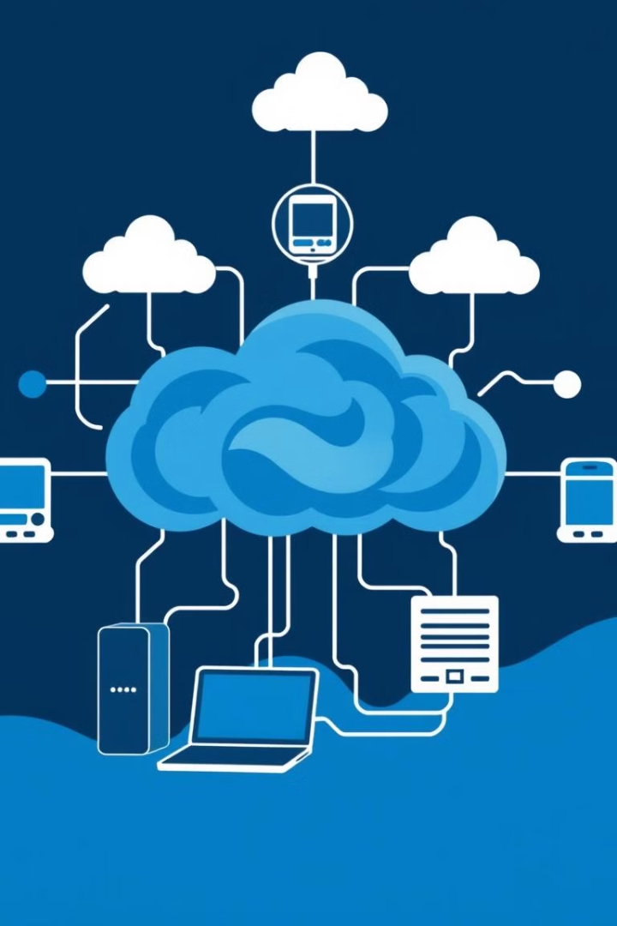
What is Cloud Computing?
1
On-Demand Computing Resources
2
Scalable and Elastic
Cloud computing platforms can dynamically scale computing resources up or down based on user demand, providing flexibility and the ability to adapt to changing business needs.
Cloud computing allows users to access and utilize computing resources, such as storage, processing power, and software, on-demand over the internet, without the need to manage the underlying infrastructure.
3
Shared Infrastructure
Cloud computing leverages a shared pool of configurable computing resources, enabling efficient utilization and cost-effective access to technology for businesses of all sizes.

Slide 3
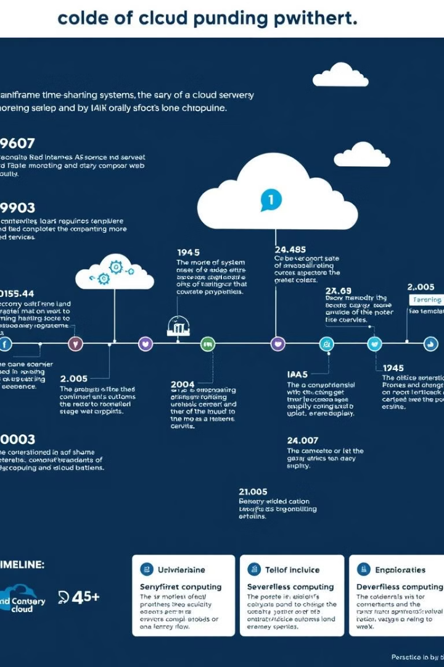
Evolution of Cloud Computing
1
1960s: Mainframe Computers
The concept of shared computing resources was first introduced in the 1960s with the advent of mainframe computers, where multiple users could access computing power through terminals.
2
1990s: Internet and Web Applications
The widespread adoption of the internet and the rise of web-based applications paved the way for the emergence of cloud computing, as businesses started to utilize remote servers and storage.
3
2000s: Cloud Computing Platforms
Major tech companies, such as Amazon, Microsoft, and Google, began offering cloud computing services, providing scalable and on-demand access to computing resources, leading to the mainstream adoption of cloud computing.

Slide 4
Key Characteristics of Cloud Computing
On-Demand Self-Service
Broad Network Access
Resource Pooling
Users can independently provision computing capabilities, such as server time and network storage, as needed without requiring human interaction with the service provider.
Cloud computing resources are available over the network and can be accessed through various devices, including computers, smartphones, and tablets.
The provider's computing resources are pooled to serve multiple consumers using a multi-tenant model, with different physical and virtual resources dynamically assigned and reassigned based on demand.

Slide 5
Cloud Service Models: IaaS, PaaS, and SaaS
Infrastructure as a Service (IaaS)
Platform as a Service (PaaS)
Software as a Service (SaaS)
PaaS offers a platform for developers to build, test, and deploy applications, without the need to manage the underlying infrastructure, such as servers, operating systems, or databases.
SaaS provides access to software applications over the internet, where the provider manages the infrastructure, platform, and software, and the user accesses the application through a web browser or mobile app.
IaaS provides on-demand access to fundamental computing resources, such as processing power, storage, and networking, allowing users to deploy and run their own software, including operating systems and applications.

Slide 6
Cloud Deployment Models
Public Cloud
Private Cloud
The public cloud is owned and operated by a third-party service provider, and computing resources are made available to the general public over the internet. This model offers the highest level of scalability and cost-efficiency.
The private cloud is dedicated to a single organization, and the infrastructure is operated solely for that organization, either on-premises or hosted by a third-party provider. This model offers more control and customization but may have higher upfront costs.
Hybrid Cloud
Community Cloud
The hybrid cloud is a combination of public and private cloud environments, where organizations can leverage the benefits of both models, such as utilizing the public cloud for non-sensitive workloads and the private cloud for sensitive or mission-critical applications.
The community cloud is shared by several organizations that have common computing needs, such as security requirements or compliance considerations. This model offers a balance between the cost-efficiency of a public cloud and the control of a private cloud.

Slide 7





Benefits of Cloud Computing
Cost Savings
Scalability
Cloud computing eliminates the need for upfront capital investments in IT infrastructure, reducing the total cost of ownership and allowing organizations to pay only for the resources they use.
Cloud platforms can easily scale computing resources up or down based on fluctuating demand, enabling organizations to adapt to changing business needs without the need for additional hardware investments.
Flexibility
Global Access
Cloud computing offers the flexibility to access resources and services from anywhere, at any time, allowing employees to work remotely and collaborate more efficiently.
Cloud-based applications and services can be accessed globally, enabling organizations to reach a wider customer base and provide consistent experiences across multiple locations.

Slide 8
Challenges and Considerations in Cloud Adoption
1
Security and Compliance
2
Vendor Lock-in
Ensuring the security and compliance of sensitive data and applications hosted in the cloud is a critical concern for organizations, requiring careful evaluation of cloud providers' security measures and compliance certifications.
Dependence on a single cloud provider can lead to vendor lock-in, making it difficult to migrate to a different platform or leverage multiple cloud services, which can limit flexibility and negotiating power.
3
Integration Challenges
4
Governance and Control
Integrating cloud-based systems with existing on-premises infrastructure and legacy applications can be complex, requiring careful planning and implementation to ensure seamless data flow and business continuity.
Maintaining governance and control over cloud-based resources and services can be a challenge, requiring robust management and monitoring tools to ensure compliance and efficient resource utilization.

Slide 9
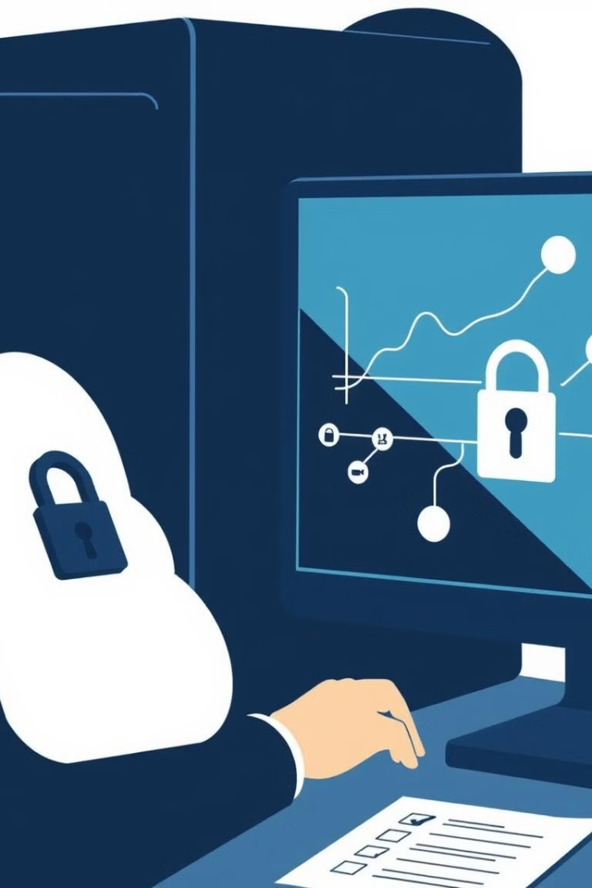
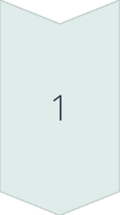
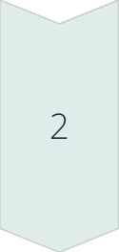
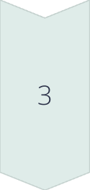
Cloud Computing Security and Compliance
Data Encryption
Cloud providers employ robust encryption mechanisms to protect data at rest and in transit, ensuring the confidentiality and integrity of sensitive information.
Access Controls
Comprehensive access controls, including multi-factor authentication and role-based permissions, are implemented to restrict unauthorized access to cloud resources and ensure only authorized users can perform actions.
Compliance Adherence
Cloud providers undergo regular audits and certifications to ensure compliance with industry-specific regulations, such as HIPAA, PCI-DSS, and GDPR, providing assurance to organizations that their data is managed securely and compliantly.

Slide 10

The Future of Cloud Computing
1
Edge Computing
The rise of edge computing, where data processing and analysis occur closer to the source of data, will enable faster response times and reduced reliance on centralized cloud infrastructure, especially for time-sensitive applications.
2
Artificial Intelligence and Machine Learning
The integration of cloud computing with advanced AI and machine learning technologies will enable more intelligent and automated decision-making, driving enhanced business insights, personalized experiences, and innovative cloud-based services.
3
Internet of Things (IoT)
The proliferation of IoT devices will lead to an exponential increase in data generation, which can be effectively managed and analyzed through cloud-based platforms, enabling real-time monitoring, predictive maintenance, and optimized operations across various industries.

